Slide 1
OPERATING SYSTEM text book: operating system concepts by Abraham silberschatz, peter b galvin and greg gagne, 8th edition

Slide 2
CHAPTER 1 : Introduction
What is operating system?
An operating system is a program that manages the computer hardware. It also provides a basis for application programs and acts as an intermediary between the computer user and the computer hardware.
operating system goals:
Execute user programs and make solving user problems easier.
Make the computer system convenient to use.
Use the computer hardware in an efficient manner.
Examples of os :
Windows :
Linux:
Android :
ios:

Slide 3
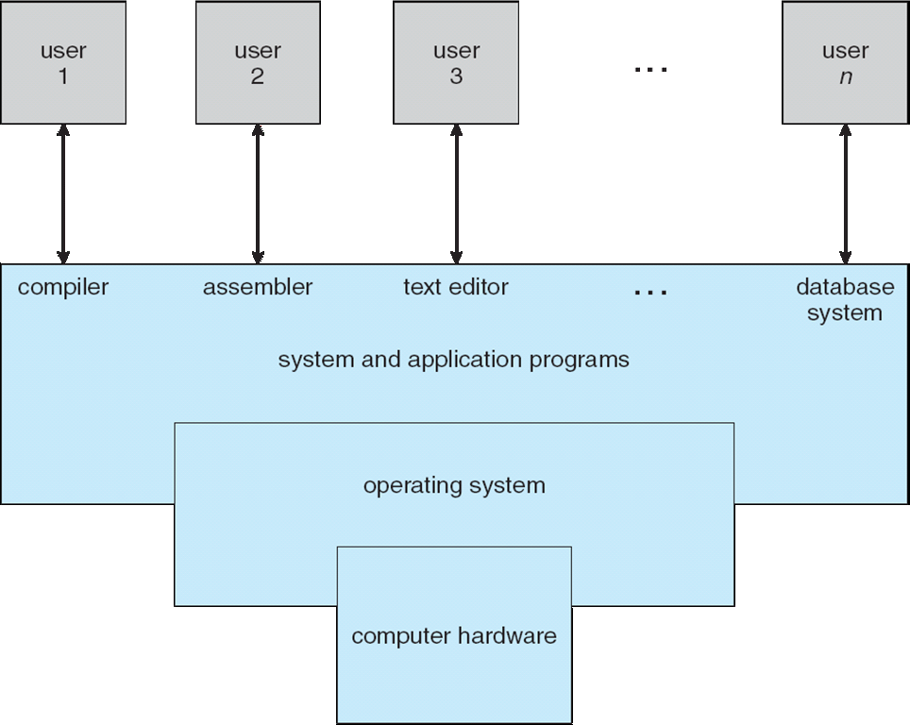
1.1 What Operating Systems Do abstract view of the components of a computer system

Slide 4
Continued..
Computer system can be divided into four components:
Hardware – provides basic computing resources
CPU, memory, I/O devices
Operating system
Controls and coordinates use of hardware among various applications and users
Application programs – define the ways in which the system resources are used to solve the computing problems of the users
Word processors, compilers, web browsers, database systems, video games
Users
People, machines, other computers.
We can also view a computer system as consisting of hardware, software and data.
An operating system is similar to a government. Like a government, it performs no useful function by itself. It simply provides an environment within which other programs can do useful work.

Slide 5
1.1.1 User view
The user's view of the computer varies according to the interface being used.
The goal is to maximize the work (or play) that the user is performing. In this case/ the operating system is designed mostly for ease of use with some attention paid to performance and none paid to resource utilization –how various hardware and software resources are shared.
In other cases, a user sits at a terminal connected to a mainframe or a minicomputer. Other users are accessing the same computer through other terminals. These users share resources and may exchange information. The operating system in such cases is designed to maximize resource utilization.
In still other cases, users sit at workstations connected to networks of other workstations and servers. These users have dedicated resources at their disposal, but they also share resources such as networking and servers. Therefore, their operating system is designed to compromise between individual usability and resource utilization.
Some computers have little or no user view. For example, embedded computers in home devices.

Slide 6
1.1.2 System view
From the computer's point of view, the operating system is the program most intimately involved with the hardware. In this context, we can view an operating system as a resource allocator.
A computer system has many resources that may be required to solve a problem: CPU time, memory space and so on. The operating system acts as the manager of these resources.
the operating system must decide how to allocate them to specific programs and users so that they are used efficiently.
A slightly different view of an operating system emphasizes the need to control the various I/0 devices and user programs.
A control program manages the execution of user programs to prevent errors and improper use of the computer.

Slide 7
1.5 operating system operations
Modern operating systems are interrupt driven. If there are no processes to execute, no I/0 devices to service, and no users to whom to respond, an operating system will sit quietly waiting for something to happen.
Events are almost always signaled by the occurrence of an interrupt or a trap.
A trap is a software generated interrupt caused by either by an error (for example divide by zero or invalid memory access) or by a specific request from a user program that an operating system service be performed.
1.5.1 dual mode operation
In order to ensure the proper execution of the operating system, we must be able to distinguish between the execution of operating-system code and user defined code.
There are two types of modes.
User mode and kernel mode(supervisory mode or privileged mode)
A bit, called mode bit is added to the hardware of the computer to indicate the current mode.
Kernel (0) ;user(1).
With the mode bit we are able to distinguish between a task that is executed on behalf of the operating system and one that is executed on behalf of the user.
When computer system is executing on behalf of a user application, the system is in user mode. However,
when a user application requests a service from the operating system (via a system call), it must transition from user to kernel mode to fulfill the request. This is shown in following fig.

Slide 8
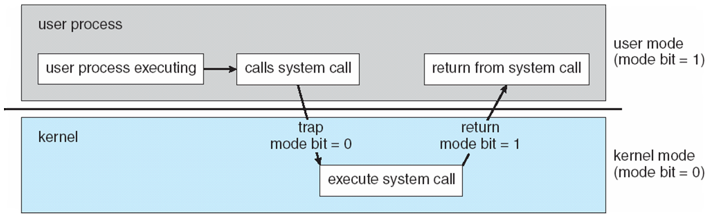
Continued..

Slide 9
Continued..
Example: At system boot time, the hardware starts in kernel mode. The operating system is then loaded and starts user applications in user mode. Whenever a trap or interrupt occurs, the hardware switches from user mode to kernel mode(that is, changes the state of the mode bit to 0).
A system call provides the means for a user program to ask the operating system to perform tasks reserved for operating system on user program’s behalf.
Some of examples which works on dual mode operation are windows XP, unix and linux.

Slide 10
1.5.2 Timer
We must ensure that operating system maintains control over CPU. We can not allow a user program to enter in infinite loop or fail to call system services and never return control to operating system. To accomplish this we can use Timer.
Timer can be set to interrupt after specific period. The period may fixed or variable.
The variable timer is implemented by a fixed rate clock and a counter. Operating system sets counter.
For instance, a 10-bit counter with a 1-millisecond clock allows interrupts at intervals from 1 millisecond to 1,024 milliseconds, in steps of 1 millisecond.
Thus, we can use the timer to prevent a user program from running too long. A simple technique is to initialize a counter with the amount of time that a program is allowed to run.

Slide 11
1.6 process management
program in execution, as mentioned, is a process. A word-processing program being run by an individual user on a PC is a process.
A process needs certain resources---including CPU time, memory, files and I/O devices to accomplish task.
A program is passive activity and process is activity.
Program counter specifies next instruction to be executed.
The operating system is responsible for the following activities in connection with process management:
1. Creating and Destroying the user and system process
2. allocating the hardware for the process
3. controlling the progress of the process
4. provides the mechanism for process communication
5. provides mechanism for deadlock handling
6. scheduling and rescheduling the process
7.provides the mechanism for process Synchronization

Slide 12
1.7 memory management
Main memory is a large array of words or bytes, ranging in size from hundreds of thousands to billions. Each word or byte has its own address.
For a program to be executed, it must be mapped to absolute addresses and loaded into memory. As the program executes, it accesses program instructions and data from memory by generating these absolute addresses.
To improve both the utilization of the CPU and the speed of the computer's response to its users multiple programs need to be there in memory.
The operating system is responsible for the following activities in connection with memory management:
Keeping track of which parts of memory are currently being used and by whom
Deciding which processes (or parts thereof) and data to move into and out of memory
Allocating and deallocating memory space as per the processes and the memeory required.
Notes:
1.Center of the modern Computers is the Memory
2. Each of the Byte can be accessed using the absolute addresses.

Slide 13
1.8 Storage management
1.8.1 File-System Management
File management is one of the most visible components of an operating system.
Computers can store information on several different types of physical media. Magnetic disk, optical disk, and magnetic tape are the most common.
Files are the logical Collection of Informaition.
Files can be Organized in Directories.
The operating system is responsible for the following activities in connection with file management.
1. Creating and Deleting the Files.
2. Creating and Deleting the Directories to Organized the Files.
3. Supporting the primitives for manipulating the files.
4. Mapping the files into storage unit.
5. Backing up the files on storage media.

Slide 14
1.8.2 Mass-Storage Management
main memory is too small to accommodate all data and programs
when power is lost
Backup of main memory is Secondary unit.
Is a mechanism in the computer system to store the information in a way that it can be retrieve later.
Main memory → data is lost when power is lost.
Secondary memory →data is retrived because we use magnetic disks, tapes other storage units.
Operating System responsible for the following activities in connection with Mass Memory
management:
Free-space management
Storage allocation
Disk scheduling
1.8.3 caching
Information is normally kept in some storage system (such as main memory). As it is used, it is copied into a faster storage system-the cache-on a temporary basis. When we need a particular piece of information, we first check whether it is in the cache. If it is, we use the information directly from the cache; if it is not we use the information from the source.

Slide 15
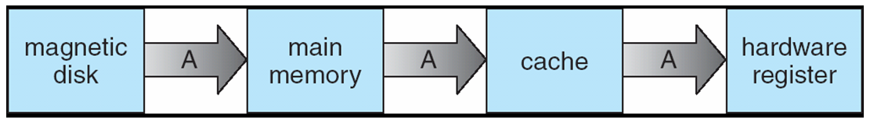
Continue…
In hierarchical storage structure, the same data may appear in different levels of the storage system.
For example, suppose that an integer A that is to be incremented by 1 located → file B, and file B → magnetic disk(in following figure).
In a computing environment where only one process executes at a time, this arrangement poses no difficulties, since an access to integer A will always be to the copy at the highest level of the hierarchy.
However, in a multitasking environment, where the CPU is switched back and -forth-among various processes extreme care must be taken to ensure that, if several processes access A, then each of these processes will obtain the most recently updated value of A.
The situation becomes more complicated in a multiprocessor environment where, in addition to maintaining internal registers, each of the CPUs also contains a local cache.
Copy of A exits simultaneously in several caches. Since the various CPUs can all execute concurrently we must make sure that update to copy of A in one cache is immediately reflected in all other caches where A resides. This situation is called cache coherency.
sdsds
A → magnetic disks → file B → Cache - - > Registors in processor

Slide 16
1.9 Protection and security
Protection, then, is any mechanism for controlling the access of processes or users-to the resources defined by a computer system.
Protection can improve reliability by detecting latent errors at the interfaces between component subsystems.
A system can have adequate protection but still be prone to failure and allow inappropriate access. Consider a user whose authentication information is stolen. Her data could be copied or deleted, even though file and memory protection are working.
It is the job of security to defend a system from external and internal attacks. Such attacks spread across a huge range and include viruses and worms, denial-of service attacks.
Protection and security require the system to be able to distinguish among all its users. Most operating systems maintains a list of user names and associated user identifiers.
In some circumstances, we wish to distinguish among sets of users rather than individual users. For example, the owner of a file on a UNIX system may be allowed to issue all operations on that file, whereas a selected set of users may only be allowed to read the file. To accomplish this, we need to define a group name and the set of users belonging to that group.

Slide 17
Distributed systems
A distributed system is a collection of physically separate, possibly heterogeneous, computer systems that are networked to provide the users with access to the various resources that the system maintains.
Access to a shared resource increases computation speed, functionality, data availability, and reliability.
A network in the simplest terms, is a communication path between two or more systems.
Distributed systems depend on networking for their functionality. Networks vary by the protocols used, the distances between nodes, and the transport media.
TCP /IP is the most common network protocol. Likewise, operating system support of protocols varies. Most operating systems support TCP /IP, including the Windows and UNIX operating systems.
Networks are characterized based on the distances between their nodes. A local area network(LAN) connects computers within a room, a floor, or a building.
A wide area network(WAN) usually links buildings, cities, or countries.
A Metropolitan area network(MAN) could link buildings within a city.
3 types → protocols , distance between modes and transmission media……..

